Slide 1
Experiment e - Figures

Slide 2
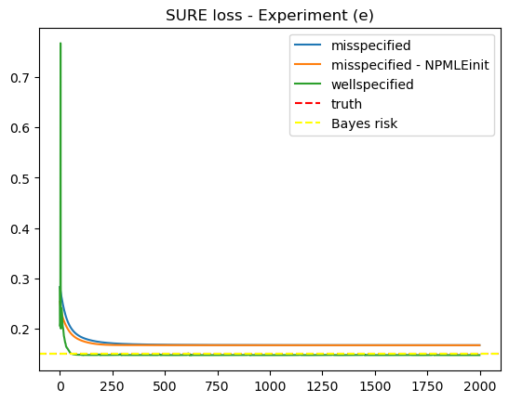
Simulation 1 – n = 1000
SURE at ground truth = 0.1498

Slide 3
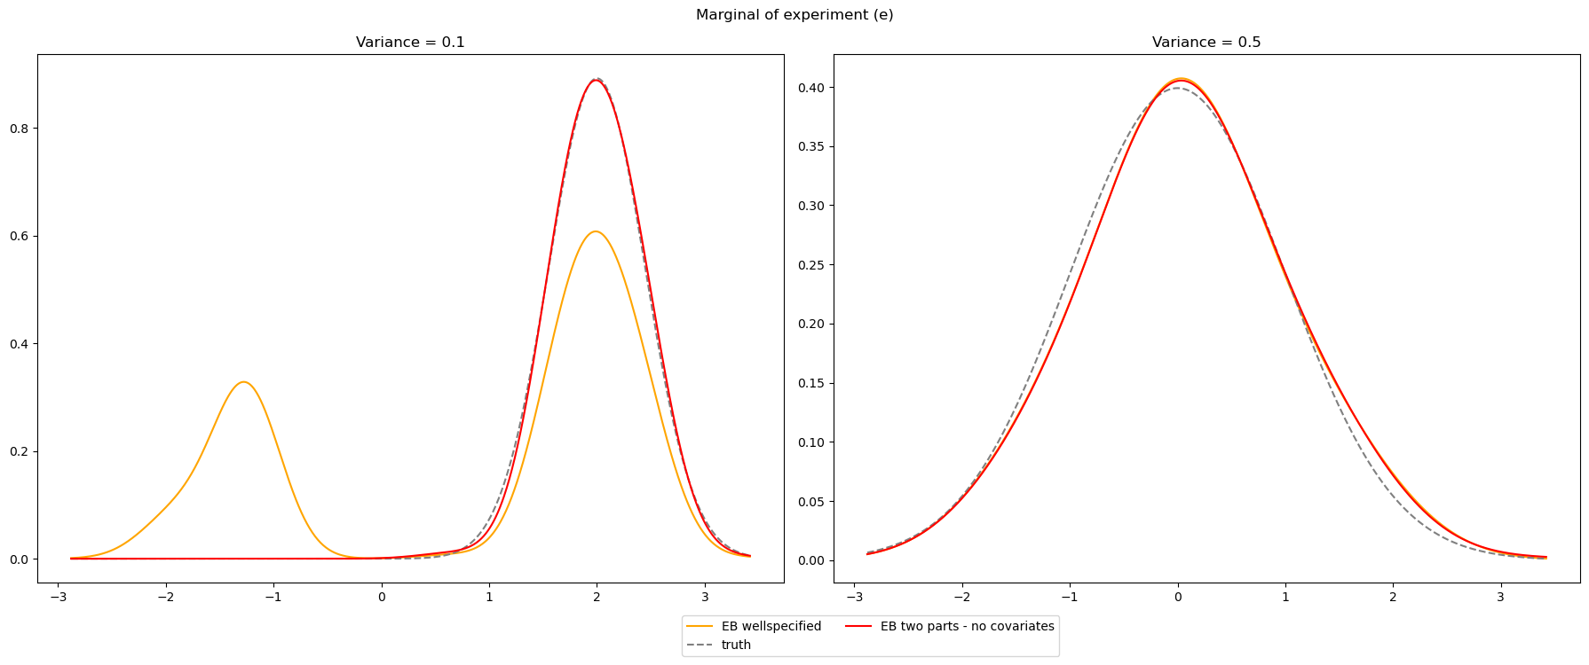
Simulation 1 – n = 1000
SURE at ground truth = 0.1498

Slide 4
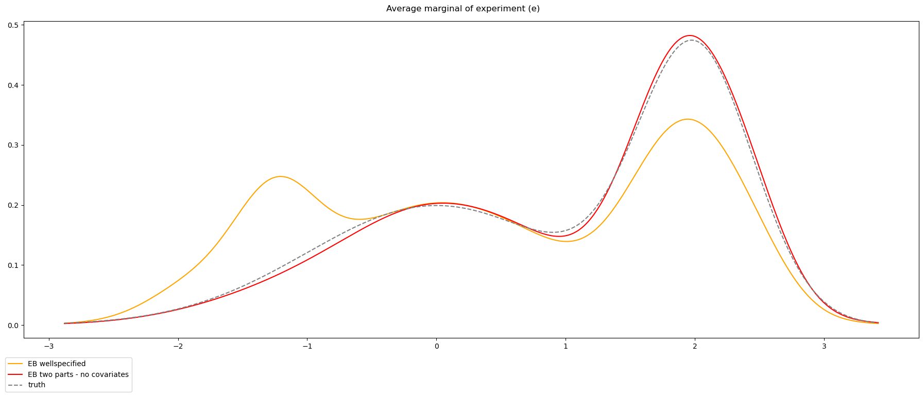
Simulation 1 – n = 1000
SURE at ground truth = 0.1498

Slide 5
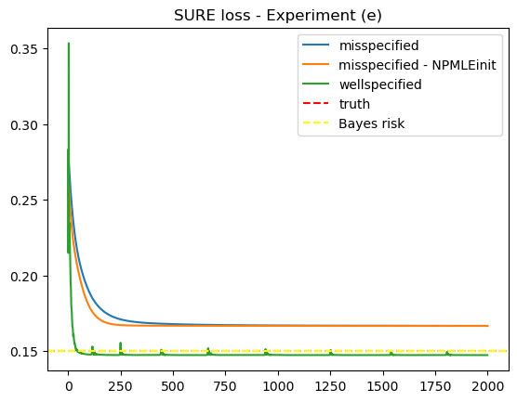
Simulation 2 – n = 1000
SURE at ground truth = 0.1500

Slide 6
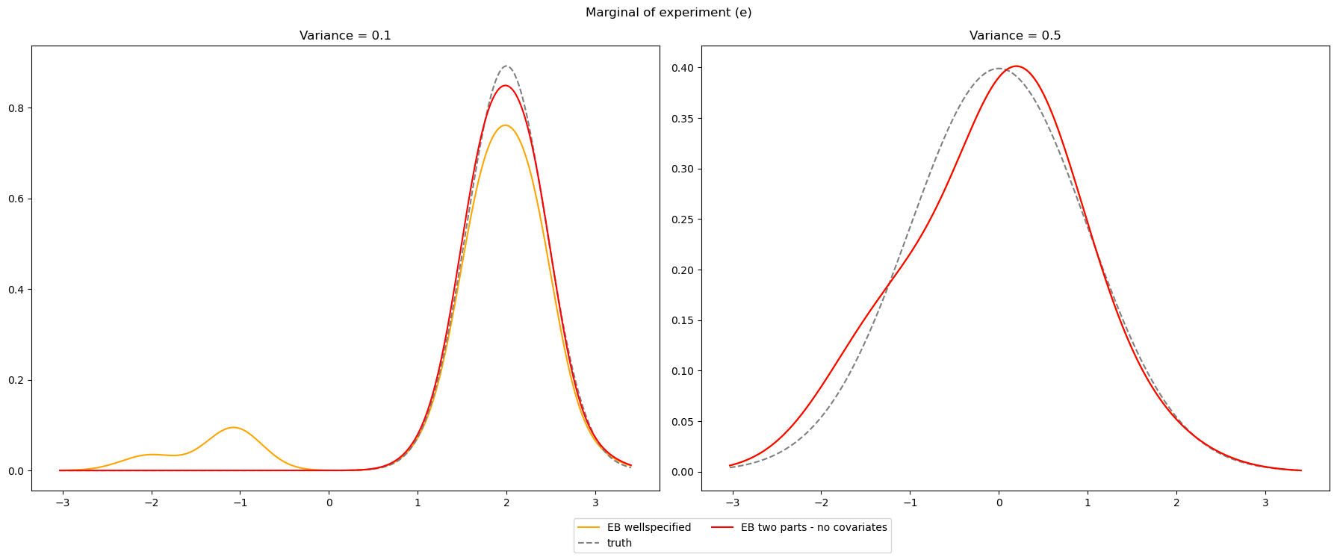
Simulation 2 – n = 1000
SURE at ground truth = 0.1500

Slide 7
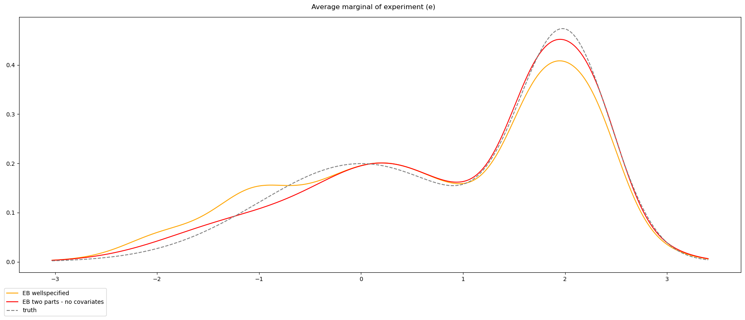
Simulation 2 – n = 1000
SURE at ground truth = 0.1500

Slide 8
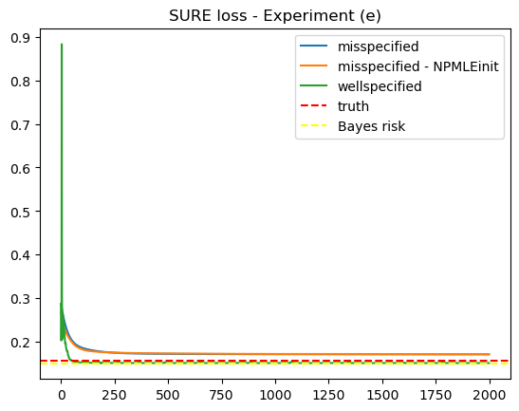
Simulation 3 – n = 1000
SURE at ground truth = 0.1576

Slide 9
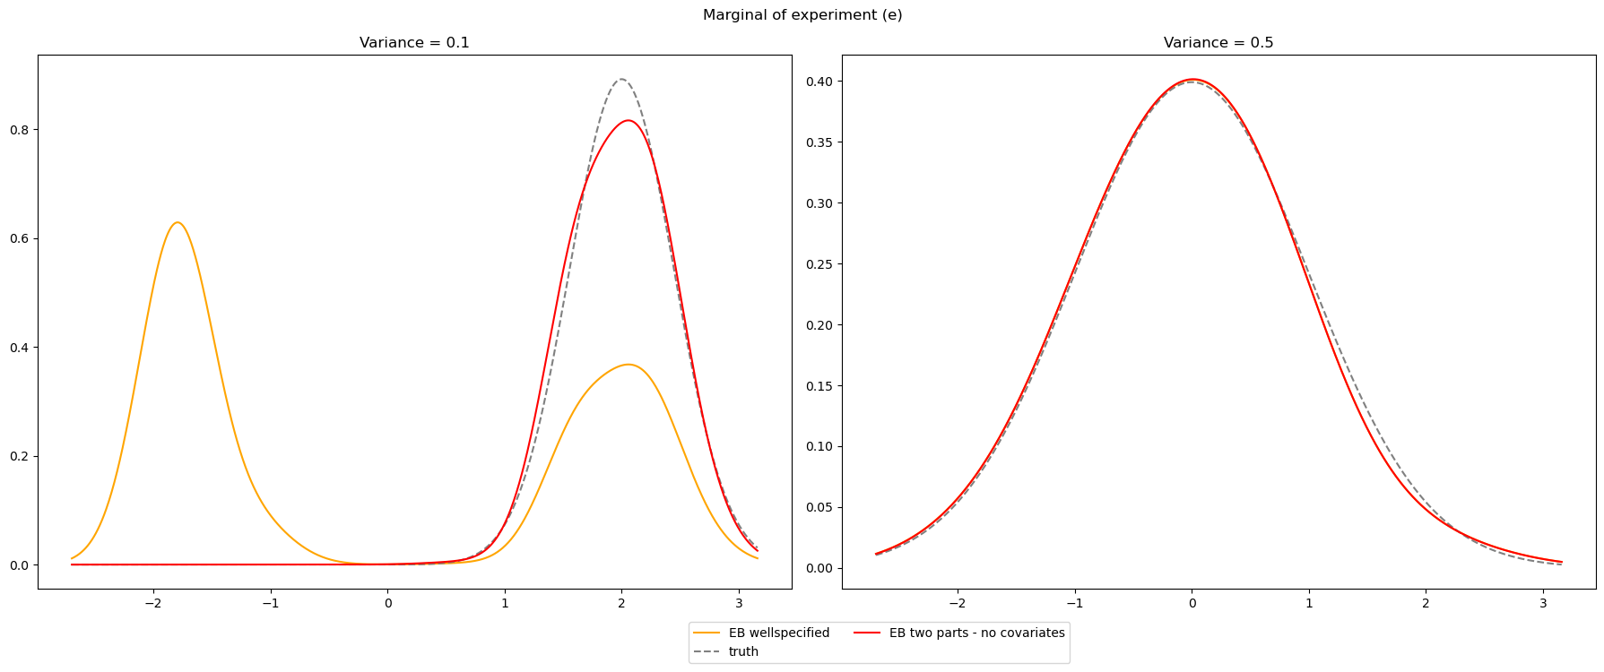
Simulation 3 – n = 1000
SURE at ground truth = 0.1576

Slide 10
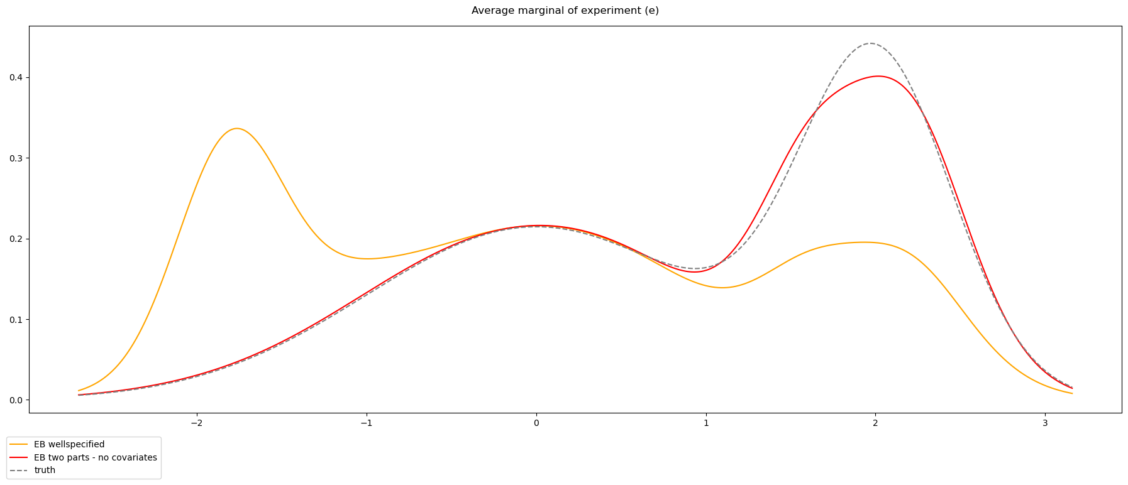
Simulation 3 – n = 1000
SURE at ground truth = 0.1576

Slide 11
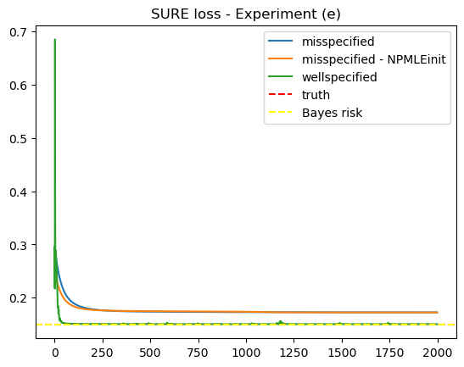
Simulation 1 – n = 10000
SURE at ground truth = 0.1501

Slide 12
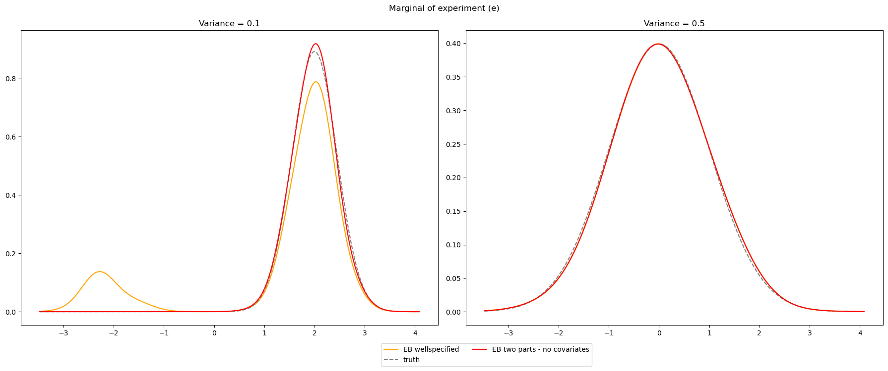
Simulation 1 – n = 10000
SURE at ground truth = 0.1501

Slide 13
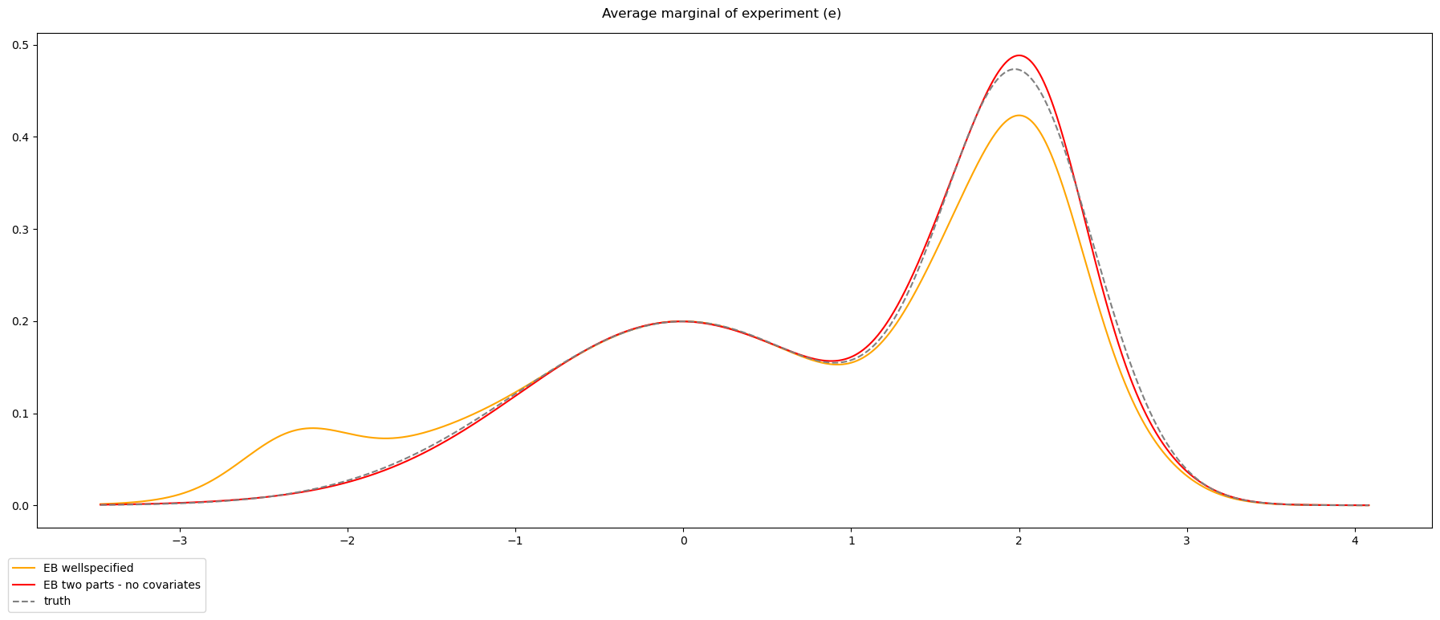
Simulation 1 – n = 10000
SURE at ground truth = 0.1501

Slide 14
Trying out single layers - (8,) and (32,)
20 runs
Single layers outperforms in some experiments & does worse in others…
Maybe due to different runs of the dataset?

Slide 15
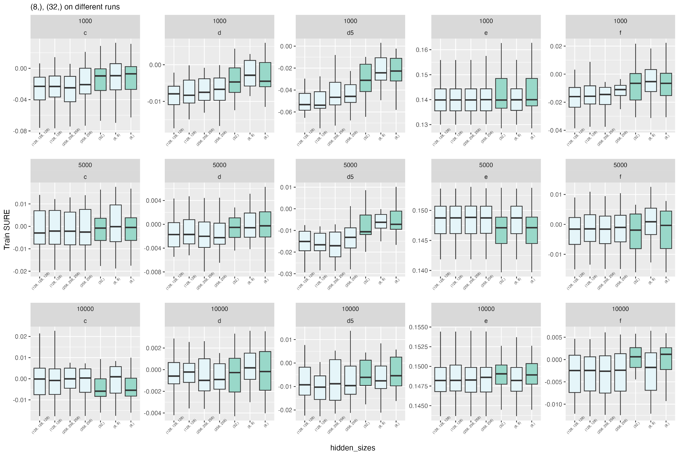

Slide 16
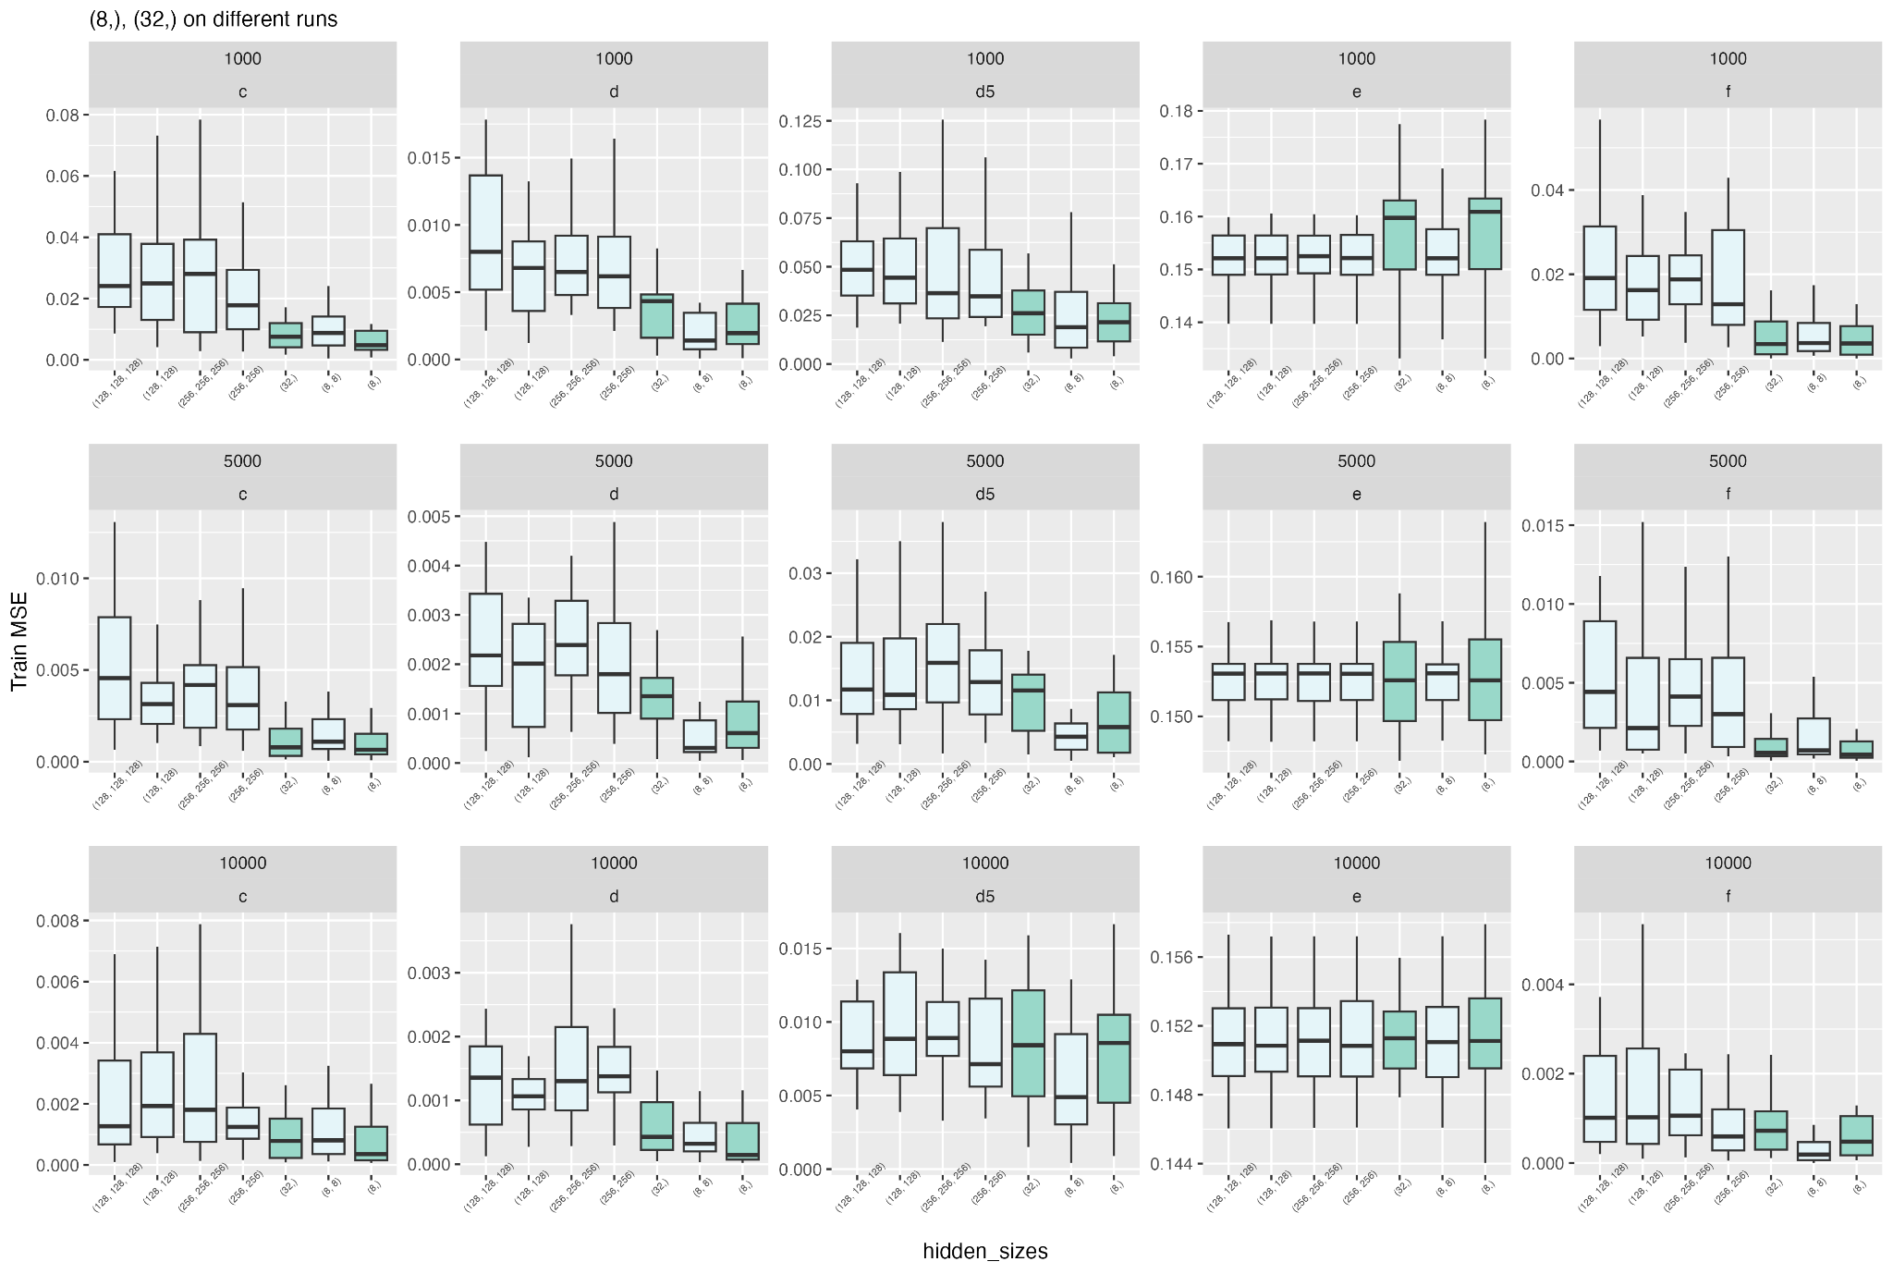

Slide 17

Translation
For no covariates EB, the translation is a parameter.
For covariates EB, should the translation also be a parameter? Or output of NN?
$$α(z_{i})$$

